Slide 1
Being an employer using Direct Payments
Rachel Mason
Family carer
Direct payment manager for her 2 sons with Learning disabilities & Autism

Slide 2
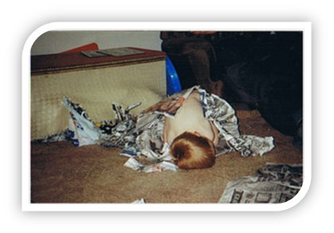
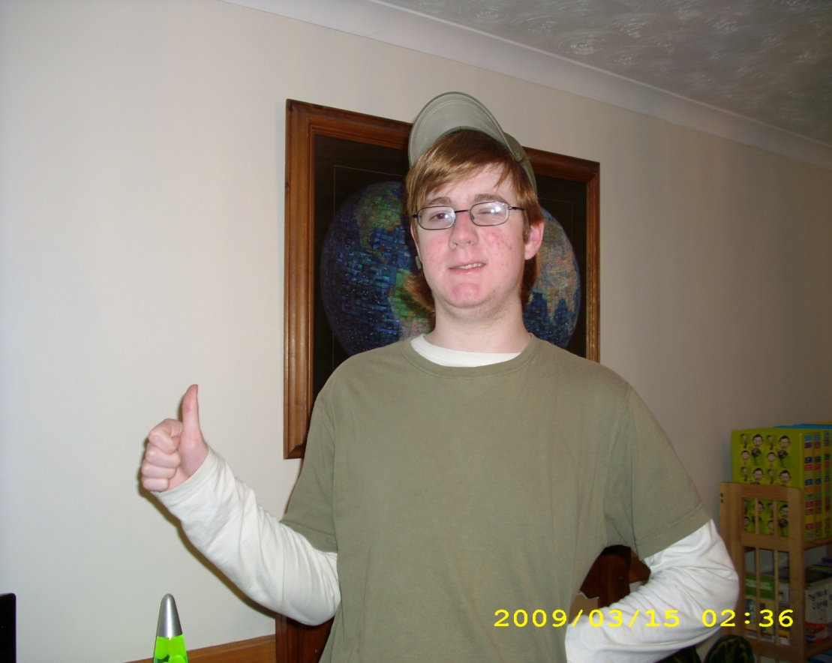
Our aspirations
Goals and outcomes:
Maintain their tenancy
Increase Independent living
Health & wellbeing
Social skills
Build friendships
Integrate into their community
Volunteer/employment
Public transport
Continue learning:
Increase vocabulary
Numeracy
Literacy
Keeping safe

Slide 3
What we have tried
Commissioned services
Agency Live in
Local live in
Local day opportunities
Employ local PAs
Engage local micro providers

Slide 4
Recruitment
Local People
Attitude – aspiration for my sons (buy in)
Commitment
Common Sense Humour
Local Knowledge Patience
Community Engagement Initiative
Natural skills +Risk taker
Team player
Willingness to stretch & challenge and support the consequences of choices made
DBS
Qualifications

Slide 5
Matching essential
Age
Male & female worked well
Car driver
Non Smoker
No perfume
Clear English
Low monotone voice
Minimal engagement

Slide 6
Induction
In place:
A contract
Health & Safety
Risk assessment
Lone working
Employer’s liability insurance
Public liability for boys
Get to know our boys (PCP/Care plan)
Introduced to their ‘Circle of support’
The working environment
The community links thus far
Meet the team
Shadowing
Probation (2 way)

Slide 7
Traditional social care training
Manual Handling
Safeguarding adults
Health & Safety
Fire Safety
Food Safety & catering
Infection control
First Aid
Medication handling
MCA and DoLs
Dementia

Slide 8
Our training priorities*
Person centred Planning
Resource Making
Social stories
Communication
PBS/Intensive Interaction
Community connecting
Enabling
Use of assistive technology

Slide 9
Retention
Respectful relationship
Partnership ( Buy in)
Trust
Celebration (Rewarding progress)
On call back up
Regular Supervision
Support weaknesses with training
Good communication channels
Constructive criticism (2 way)
Clear goals with freedom to deliver
Our willingness to respond to employees lives

Slide 10
Sustainability v Success
The aim within the contract was to “Do yourself out of the job”
Build community awareness*
Community confidence
Assistive technology
Ownership of their progress
Pooling budgets
Sharing PAs with other families*
Reduce reliance on paid support
Time banking ‘community credits’
Partnership with SW and DP team*
CONTRACT...

Slide 11
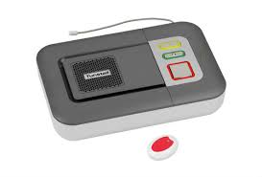
Contingency planning
On call support/’retainer’
Community connecting pays off*
Care line installed
Assistive technology
Prompting Resources
Safe places
ICE card
Bad weather
No buses
No Direct Payment!

Slide 12
Observations & Suggestions to support a tapered approach
Limited Personal development/progression
Less qualified doesn't mean poor quality
How can we introduce standards without choking individual, less formal arrangements
Recognition for informal training gained

Slide 13
Observations & Suggestions to support a tapered approach
How can we encourage more commissioning of
‘Just enough support’ and tapered approaches
to care & support
How do ‘DP employers’ support sustainable employment for their workers
Investment in PA registers, PA pool of availability
Quovita – Self Employed Micro providers

